Slide 1
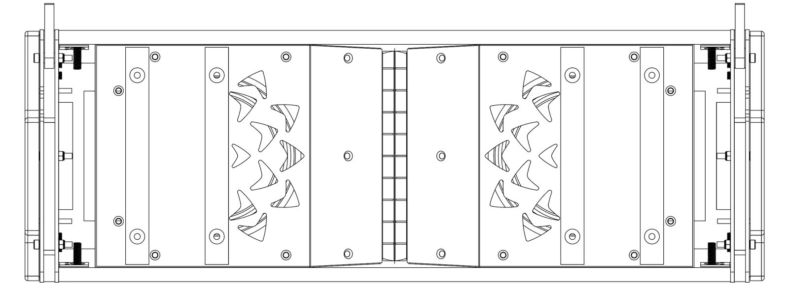
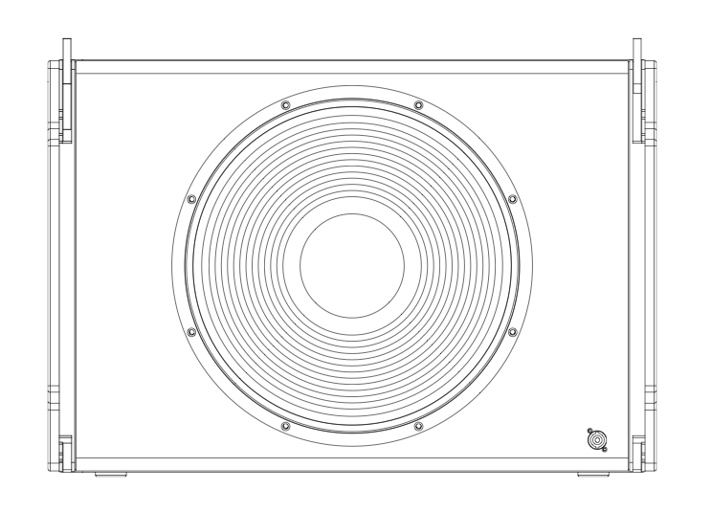
4 x XLA-308
4 x XLA-308
DP-4100F x2
Ch 1 (LF) Ch 2 (HF)
Ch 3 (LF) Ch 4(HF)
Ch 1 (LF) Ch 2 (HF)
Ch 3 (LF) Ch 4 (HF)
DP-2200F x2
2 x XLA-118SUB
2 x XLA-118SUB
XLA SYSTEM (GROUNDSTACK)
*Dolly Frame not shown

Slide 2
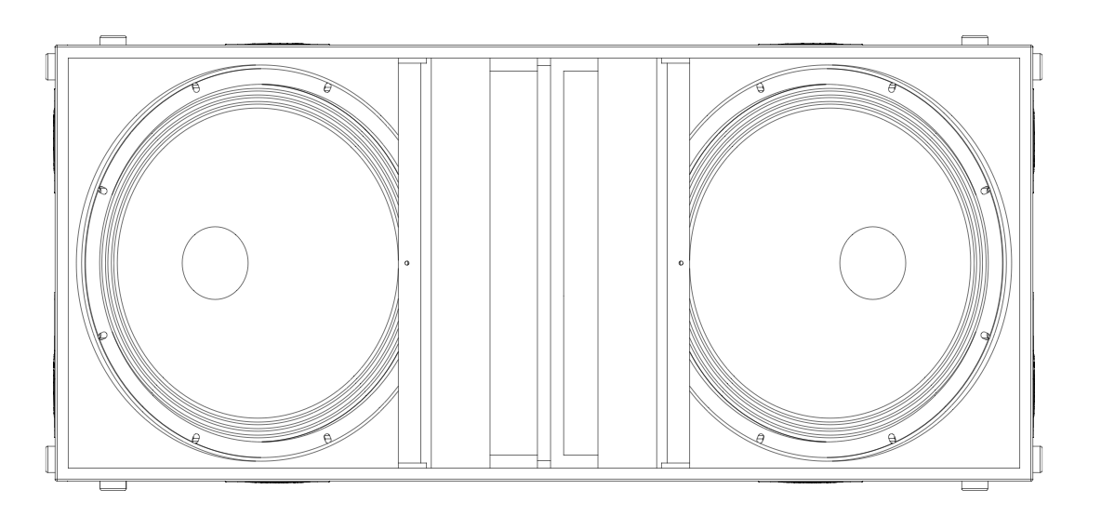
6 x XLA-308
DP-4100F x 3
6 x XLA-308
Ch 1 (LF) Ch 2 (MHF)
Ch 3 (LF) Ch 4 (MHF)
Ch 1 (LF) Ch 2 (MHF)
Ch 3 (LF) Ch 4 (MHF)
Ch 1 (LF) Ch 2 (MHF)
Ch 3 (LF) Ch 4 (MHF)
DP-2200F(N) x 2
DP-2200F(N) x 2
Ch 1 (1+, -1) Ch 2 (2+, -2)
Ch 1 (1+, -1) Ch 2 (2+, -2)
Ch 1 (1+, -1) Ch 2 (2+, -2)
Ch 1 (1+, -1) Ch 2 (2+, -2)
XLA-221SUB x2
XLA SYSTEM (FLOWN w/ SUBS GS)
XLA-221SUB x2
*Common Fly Frame not shown

